Slide 1
A Biaxial Tissue Stretcher
Client: Frank Yin, MD. Ph.D
Group 30
Joshua Leibowitz
Krista Vedvik
Christopher Zarins

Slide 2
Background
Cells in the body experience mechanical forces
Heart
Lungs
Blood vessels
Laboratory cell cultures should recreate physiological conditions so the cell’s physiological responses can be studied

Slide 3
Need for a Biaxial Cell Stretcher
Studying the effects of mechanical force on aortic endothelial cells
Orientation and organization of cells depends on exact stretching qualities
Controlling deformation in both directions gives the most accurate and meaningful results

Slide 4
Design Requirements
Parameter | Value
Maximum Strain | 40%
Strain Resolution | 0.50%
Maximum Strain Rate | 40% / s
Maximum Operating Frequency | 2 Hz
Device Size | 50 cm W x 50 cm D x 60 cm H
Operating Temperature | 37.5 ˚ C
Operating Humidity | 100%
Substrate Stiffness | 100 kPa
Culture Size | 5 cm x 5 cm
Cost | < $35,000

Slide 5
Overview of Design Alternatives
Superstructure
Drive Mechanism
Membrane Fixation

Slide 6
Superstructure
Single Lever Arms
Parallelogram Linkage
Fixed Linear Rail
Sliding Linear Rail

Slide 7
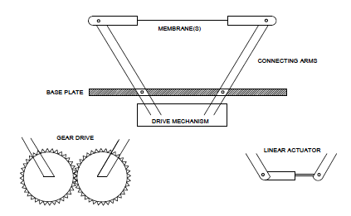
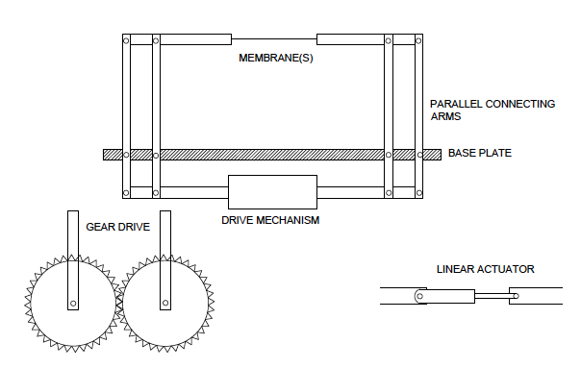
Superstructure: Mechanical Linkage
Single Lever Arm
Parallelogram Arm

Slide 8
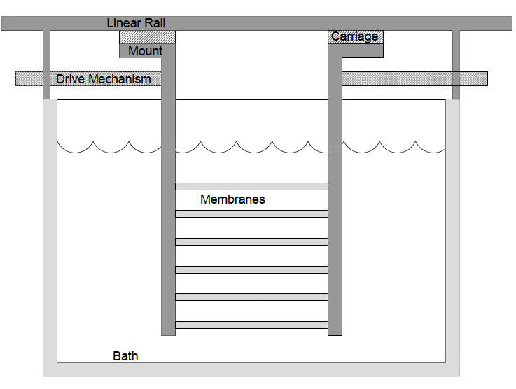
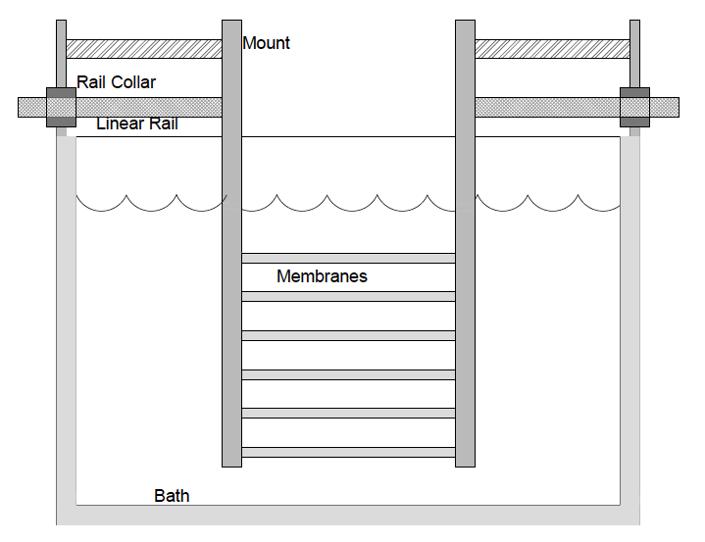
Superstructure: Linear Rails
Fixed Linear Rail
Sliding Linear Rail

Slide 9
Superstructure Pugh Analysis
Superstructure
 | Weight | Sliding Linear Rail | Fixed Linear Rail | Single Lever Arm | Parallelogram Linkage
Precision | 8 | 7 | 8 | 7 | 6
Minimizing Fluid Shear | 7 | 8 | 8 | 1 | 3
Ease of Calibration | 6 | 10 | 10 | 2 | 4
Cost | 6 | 8 | 7 | 4 | 3
Ease of setup | 6 | 8 | 8 | 4 | 6
Optical Accessibility | 6 | 10 | 3 | 10 | 10
Multiple Membrane Capabilities | 4 | 9 | 10 | 1 | 6
Total |  | 364 | 328 | 187 | 231

Slide 10
Drive Mechanism
Motor with Cam Drive
Stepper Motor with Rack Drive
Stepper Motor with Worm Drive
Stepper Motor with Lever Arms
Linear Actuator with Direct Fixation

Slide 11
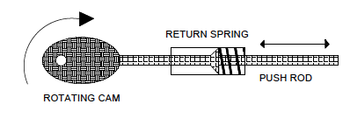
Drive Mechanism – Cam Drive

Slide 12
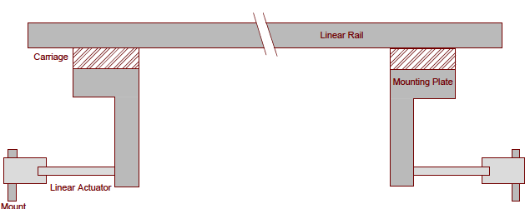
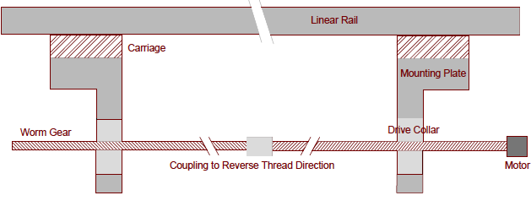
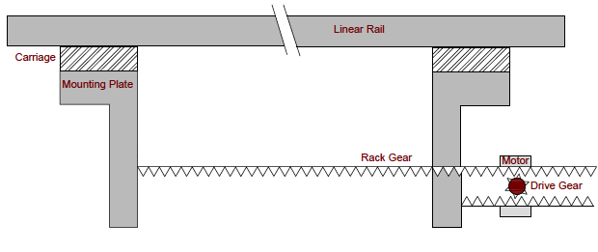
Drive Mechanism
Linear Actuator
Stepper Motor with Worm Drive
Stepper Motor with Rack Drive

Slide 13
Drive Mechanism Pugh Analysis
Drive Mechanism
 | Weight | Linear Actuator w/ Direct Fixation | Stepper Motor w/ Worm Gear | Stepper Motor w/ Rack Drive | Stepper Motor w/ Lever Arms | Motor w/ Cam Drive
Drive Precision | 9 | 10 | 8 | 4 | 5 | 2
Speed | 8 | 9 | 9 | 10 | 10 | 10
Cost | 8 | 1 | 8 | 8 | 9 | 10
Calibration | 7 | 10 | 7 | 8 | 5 | 1
Ease of setup | 6 | 10 | 9 | 9 | 9 | 2
Durability | 5 | 8 | 8 | 9 | 8 | 6
Total |  | 340 | 351 | 335 | 326 | 227

Slide 14
Membrane Fixation
Fixation Strategy
Sutures
Clamps
Desirable Qualities
Region of uniform strain
Ease of setup

Slide 15
Finite Element Analysis
Clamp Fixation
Suture Fixation

Slide 16
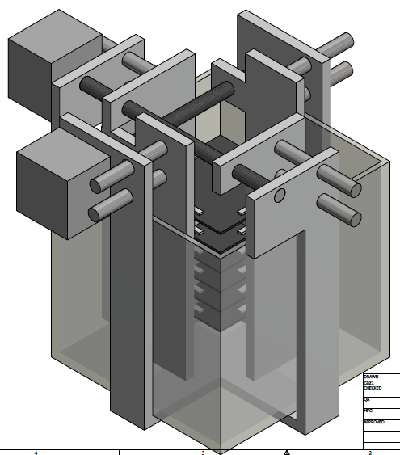
Our Chosen Design

Slide 17
Design Schedule
Task/Milestone | Nov. |  |  |  | Dec.
 | 5 | 12 | 19 | 26 | 3 | 10
Parts Research
Conceptualization of Final Design
Fluid Shear Finite Element Simulations
CAD Renditions
Risk Analysis & DesignSafe
Website Finalization
Feasibility Report
Final Oral Report
Final Written Report
Project Poster Judging

Slide 18
Member Responsibilities
 | Chris | Josh | Krista
Conceptualization
 | x | x | x
Device Components
Substrate | x
Drive Mechanism |  |  | x
Controller Interface | x
Incubator Compatibility |  |  | x
Imaging Compatibility |  | x
Calibration |  | x
Risk Analysis
DesignSafe |  | x
Research
Feasibility | x | x | x
Literature Searches |  | x
Mathematical Parameters | x
Prices/Quotes |  |  | x
Final Report
Initializing |  | x
Scheduling/Labor Division |  |  | x
Figures |  |  | x
Copy-editing | x
Final Presentation
 |  |  | x
Final Poster
 | x | x | x
Client Interactions
 | x |  | x
Intellectual Property
 |  |  | x
Website
 |  | x

Slide 19
References
Balland, M., et. al. Power Laws in Microrheology Experiments on Living Cells: Comparative Analysis and Modeling. Phys. Rev. E Stat. Nonlinear Soft Matter Phys. 74, (2006)
Collinsworth, A. et. al. Apparent Elastic Modulus and Hysteresis of Skeletal Muscle Cells Throughout Differentiation. Am. J. Cell Physiol. 283, C1219-C1227 (2002)
McGarry, J. et. al. A Comparison of Strain and Fluid Shear Stress in Stimulating Bone Cell Responses- A Computational and Experimental Study. FASEB J. 19, 482-484 (2005)
Thompson, M. et. al. Quantification and Significance of Fluid Shear Stress Field in Biaxial Cell Stretching Device. Biomech. Model Mechanobiol. 10, 559-564 (2011)
Yin, F., Chew, P., Zeger, S. An Approach to Quantification of Biaxial Tissue Stress-Strain Data. J. Biomech. 19, 27-37 (1986)
Zeng, D. et. al. Young’s Modulus of Elasticity of Schlemm’s Canal Endothelial Cells. Biomech. Model Mechanobiol. 9, 19-33 (2010)

Slide 20
Questions?

