Slide 1
A Biaxial Tissue Stretcher
Client: Frank Yin, MD. Ph.D
Group 30
Joshua Leibowitz
Krista Vedvik
Christopher Zarins

Slide 2
Need for a Biaxial Cell Stretcher
Studying the effects of mechanical force on aortic endothelial cells
Orientation and organization of cells depends on exact stretching qualities
Controlling deformation in both directions gives the most accurate and meaningful results

Slide 3
Design Requirements
Parameter | Value
Maximum Strain | 40%
Strain Resolution | 0.50%
Maximum Strain Rate | 40% / s
Device Size | 19.5 in W x 19.5 in D x 23 in H
Operating Temperature | 37.5 ˚ C
Operating Humidity | 100%
Central Region of Uniform Strain | 1 cm x 1 cm
Cost | < $35,000

Slide 4
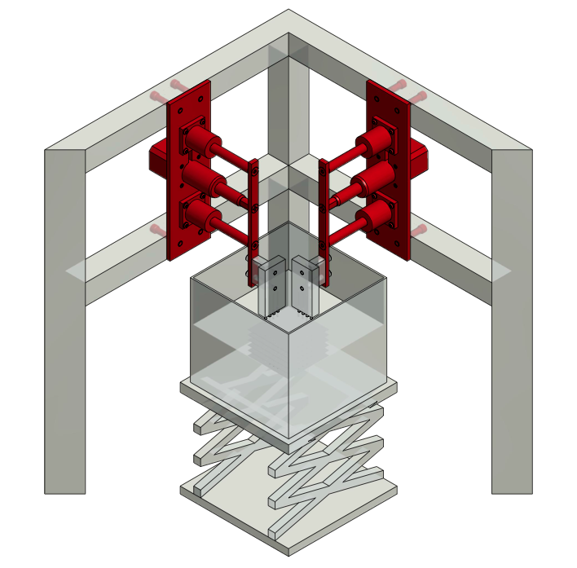
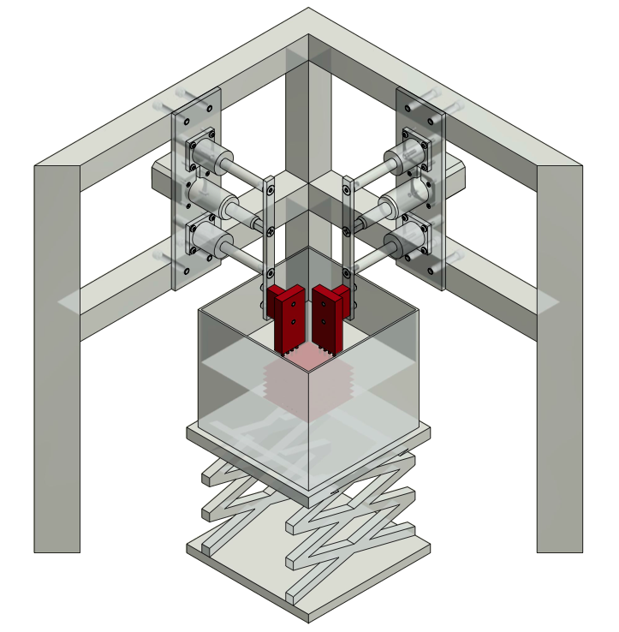
Overview of Design Concept
Four linear actuators mounted above bath
Membrane rods for fixation mechanism

Slide 5
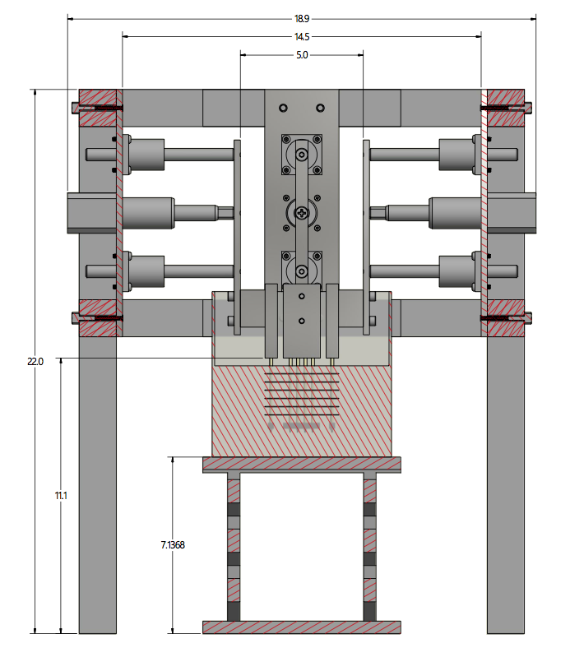
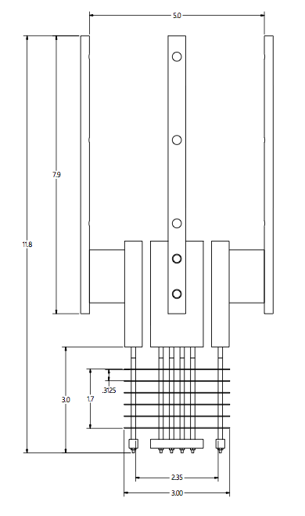
Overview of Design Concept

Slide 6
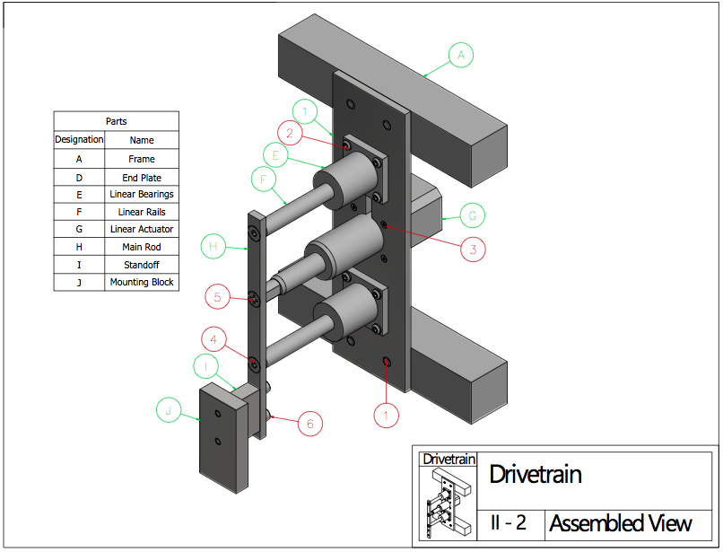
Drivetrain: Details

Slide 7
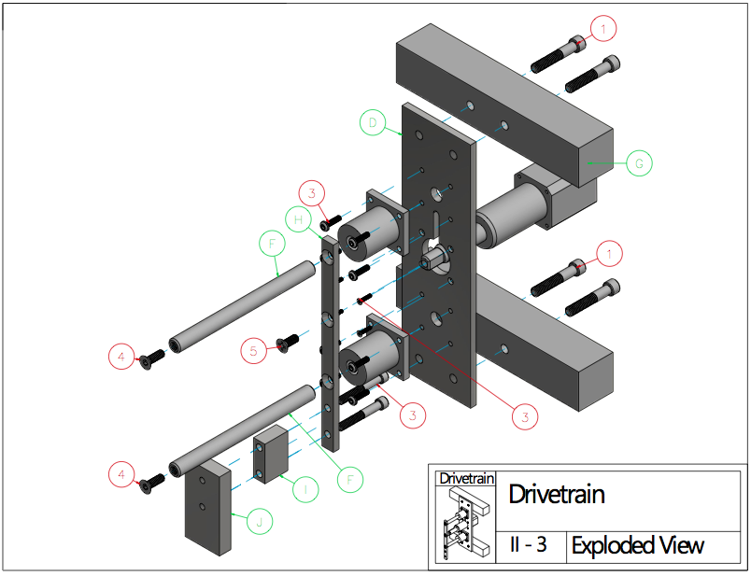
Drivetrain: Assembly

Slide 8
Drivetrain: Analysis
Force
Required force:
Actuator spec: 75 lb max
Resolution
0.5% during 0.5 in. stretch=0.0025 in
Actuator spec: 0.0004 in/step
Speed
0.5 in/sec for 40% stretch/sec
Actuator spec: 3.3 in/sec

Slide 9
Drivetrain: Analysis
Aluminum 6061 Alloy
For machined parts
Corrosion resistant
Relatively inexpensive
Reduces total weight by 20% compared to steel

Slide 10
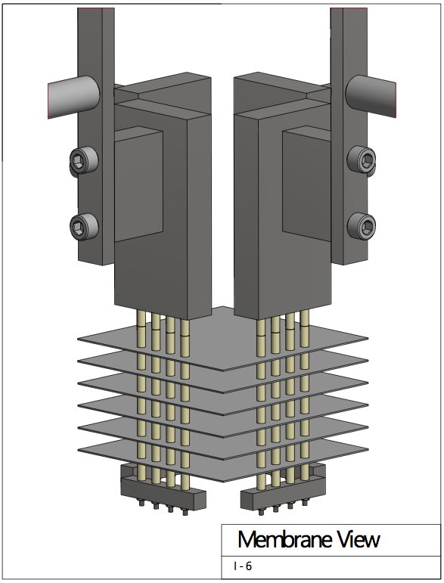
Membrane Fixation: Details

Slide 11
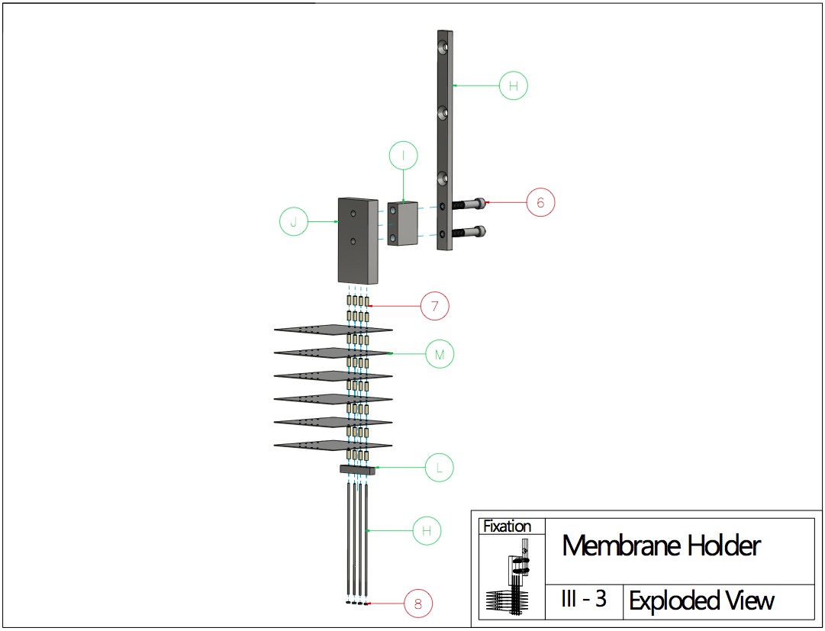
Membrane Fixation: Assembly

Slide 12
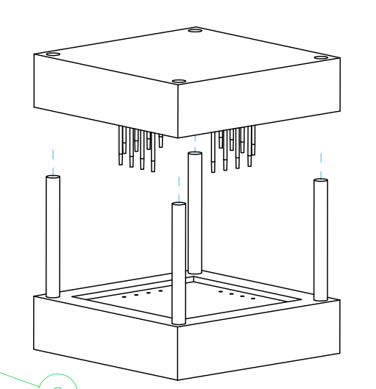
Membrane Punch

Slide 13
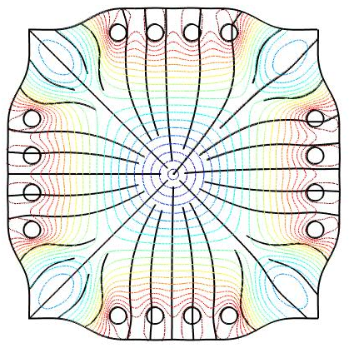
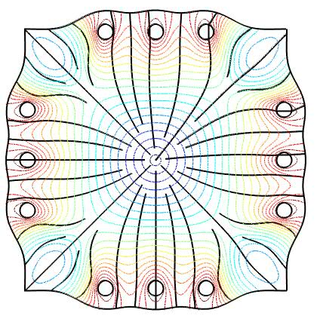
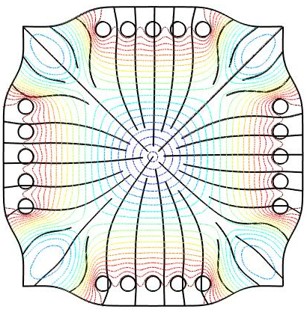
Membrane Fixation: Analysis
Membrane rods
Middle ground between sutures and clamps
Mitigate fluid shear
Finite Element Simulations

Slide 14
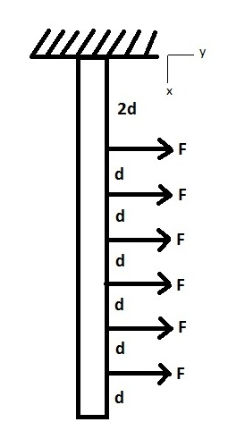
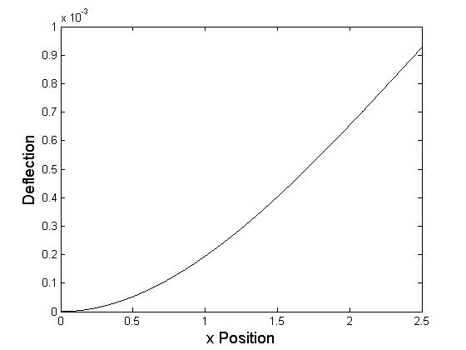
Membrane Fixation: Analysis
Membrane Rods
Some resolution decrease due to bending
Euler-Bernoulli Theorem

Slide 15
Parts and Manufacturing
Drivetrain Manufacturing Specifics
Part | Manufacturer | Part Number | Quantity | Ind. Cost | Ind. Weight (lb) | Lead Time
End Plate | Firstcut | Quote # 253294 | 4 | $218 | 0.68764 | 5-14 bus. days
Linear Bearings | McMaster-Carr | 64825K11 | 8 | $59.51 | 0.4 | 3-7 bus. days
Linear Rails | McMaster-Carr | 1240K51 | 8 | $51.12 | 0.335 | 3-7 bus. days
Linear Actuator | Ultramotion | D-A.063-IPX17-2-/4-ESD | 4 | $875 | 1.1 | 8 weeks
Stepper Controller | Ultramotion | ST5-Q | 4 | $360 | 0 | 8 weeks
Stepper Controller Power Supply | McMaster-Carr | 7010K71 | 1 | $277.27 | 0 | 3-7 bus. days
Terminal Block | McMaster-Carr | 7527K45 | 1 | $2.35 | 0 | 3-7 bus. days
Main Rod | Firstcut | Quote # 253294 | 4 | $126 | 0.08852 | 5-14 bus. days
Total |  |  |  | $7,481 | 13.38464
Membrane/Membrane Fixation Manufacturing Specifics
Part | Manufacturer | Part Number | Quantity | Ind. Cost | Ind. Weight (lb) | Lead Time
Standoff | Firstcut | Quote # 253294 | 4 | $88 | 0.06459 | 5-14 bus. days
Mounting Block | Firstcut | Quote # 253294 | 4 | $132 | 0.21941 | 5-14 bus. days
Membrane Rods | McMaster-Carr | 88915K37 | 1 | $10.88 | 0.335 | 3-7 bus. days
Bottom Rod Support | Firstcut | Quote # 253294 | 4 | $78 | 0.00902 | 5-14 bus. days
Needles | Vita Needle | N/A | 1 | $30 | 0 | 1-2 weeks
Alignment Rods | McMaster-Carr | 4416T12 | 1 | $6.27 | 0 | 3-7 bus. days
Top Punch | Firstcut | Quote # 253294 | 1 | $169 | 0 | 5-14 bus. days
Bottom Punch | Firstcut | Quote # 253294 | 1 | $189 | 0 | 5-14 bus. days
Total |  |  |  | $1,597 | 1.50708

Slide 16
Parts and Manufacturing
Fastener Manufacturing Specifics
Part | Manufacturer | Part Number | Quantity | Pkg. Cost | Ind. Weight (lb) | Lead Time
Frame to end plate | McMaster-Carr | 92185A589 | 16 | $5.75 | 0.047 | 3-7 bus. days
Linear bearing to end plate | McMaster-Carr | 96710A321 | 32 | $10.43 | 0.005 | 3-7 bus. days
End plate to L.A. | McMaster-Carr | 92703A211 | 16 | $8.21 | 0.001 | 3-7 bus. days
Into threaded end of rail | McMaster-Carr | 92703A408 | 8 | $6.96 | 0.01 | 3-7 bus. days
Into threaded end of L.A. | McMaster-Carr | 91771A557 | 4 | $9.60 | 0.009 | 3-7 bus. days
Mounting block to main rod | McMaster-Carr | 92185A548 | 8 | $6.67 | 0.029 | 3-7 bus. days
Membrance Spacers | McMaster-Carr | 94639A466 | 128 | $6.13 | 0.00012 | 3-7 bus. days
Nut (support bottom of membranes) | McMaster-Carr | 90730A001 | 8 | $6.55 | 0.00029 | 3-7 bus. days
Total |  |  |  | $108 | 1.29368
Miscellaneous Parts Manufacturing Specifics
Part | Manufacturer | Part Number | Quantity | Pkg. Cost | Ind. Weight (lb) | Lead Time
Frame (entire structure) | 8020 | N/A | 1 | $750 | 16 | 3-7 bus. days
Laboratory Scissor Jack | Home Science Tools | CE-JACK8X8 | 1 | $44.95 | 0 | 7-10 bus. Days
Bath | Dynalon Labware | 451005 | 1 | $13.34 | 0 | 3-7 bus. days
Total |  |  |  | $808.29 | 16
Total Weight: 32.19 lb
Total Projected Cost: $9,994.29

Slide 17
Safety
Relatively low-risk device
Only used in laboratory setting
Trained lab assistants
Risk of pinching/poking fingers
Membrane punch
Assembly
Risk of electrical shock
Controller power supply
Degradation of linear actuator wires

Slide 18
Conclusions
Objectives met
Capable of 40% stretch at 40%/sec
Capable of double the prescribed resolution
Fits in incubator/humidity permitting
Within budget
Parameter | Constraint | Actual Value
Maximum Strain | 40% | 100%
Strain Resolution | 0.50% | >0.26%
Maximum Strain Rate | 40% / s | 264% / s
Device Size | 19.5 in W x 19.5 in D x 23 in H | 18.6 in W x 18.6 in D x 22 in H
Operating Temperature | 37.5 ˚ C | 37.5 ˚ C
Operating Humidity | 100% | 100%
Central Region of Uniform Strain | 1 cm x 1 cm | 1 cm x 1 cm
Cost | < $35,000 | ~ $10,000

Slide 19
Conclusions
No IP
No mass production
Future Directions
Prototyping and troubleshooting
Precise calibration
Better vertical access
Complex FES
Design is a dynamic process!!

Slide 20
References
Balland, M., et. al. Power Laws in Microrheology Experiments on Living Cells: Comparative Analysis and Modeling. Phys. Rev. E Stat. Nonlinear Soft Matter Phys. 74, (2006)
Collinsworth, A. et. al. Apparent Elastic Modulus and Hysteresis of Skeletal Muscle Cells Throughout Differentiation. Am. J. Cell Physiol. 283, C1219-C1227 (2002)
McGarry, J. et. al. A Comparison of Strain and Fluid Shear Stress in Stimulating Bone Cell Responses- A Computational and Experimental Study. FASEB J. 19, 482-484 (2005)
Thompson, M. et. al. Quantification and Significance of Fluid Shear Stress Field in Biaxial Cell Stretching Device. Biomech. Model Mechanobiol. 10, 559-564 (2011)
Yin, F., Chew, P., Zeger, S. An Approach to Quantification of Biaxial Tissue Stress-Strain Data. J. Biomech. 19, 27-37 (1986)
Zeng, D. et. al. Young’s Modulus of Elasticity of Schlemm’s Canal Endothelial Cells. Biomech. Model Mechanobiol. 9, 19-33 (2010)

Slide 21
Questions?

